Slide 2


What’s New In Oracle Database Application Development
Thomas Kyte
http://asktom.oracle.com/

Slide 3
The following is intended to outline our general product direction. It is intended for information purposes only, and may not be incorporated into any contract. It is not a commitment to deliver any material, code, or functionality, and should not be relied upon in making purchasing decisions. The development, release, and timing of any features or functionality described for Oracle’s products remains at the sole discretion of Oracle.

Slide 4
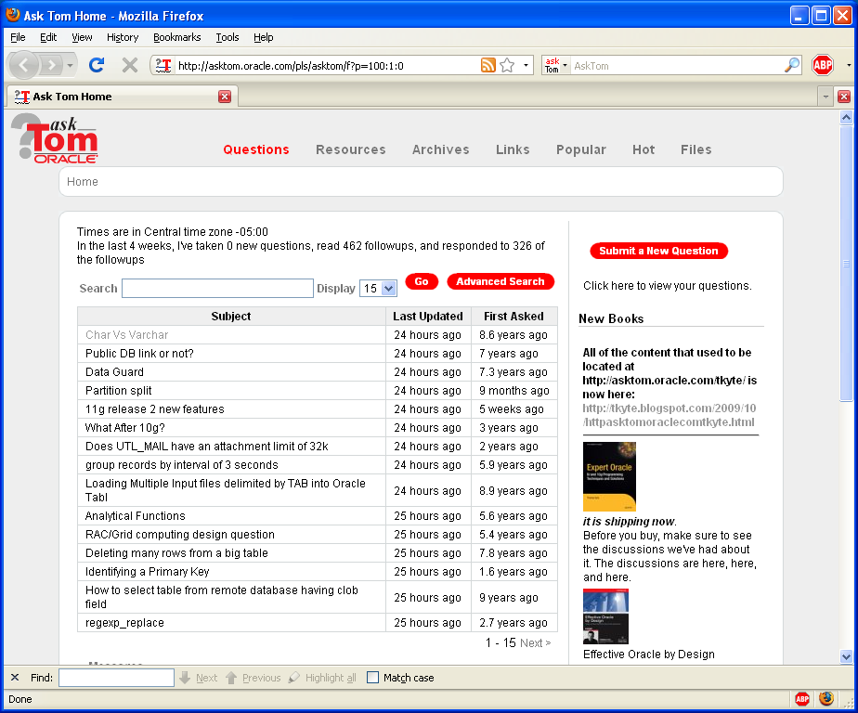



Who am I
Been with Oracle since 1993
User of Oracle since 1987
The “Tom” behind AskTom in Oracle Magazine
www.oracle.com/oramag
Expert Oracle Database Architecture
Effective Oracle by Design
Expert One on One Oracle
Beginning Oracle

Slide 5


What’s new In Oracle Application Development
<Insert Picture Here>
APEX
SQL Developer
ODP.Net
Networking
Java/PHP/others…
Database
PL/SQL

Slide 6

APEX

Slide 7

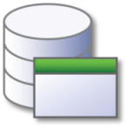
History
2011 Application Express 4.1
Data Upload, RowID, Error Handling
2010 Application Express 4.0 Websheets,
Dynamic Actions, Plug-Ins, RESTful Web
2009 Application Express 3.2 Forms Conversion
2008 Application Express 3.1 Interactive Reports, BLOB
2007 Application Express 3.0 Flash Charts, PDF Printing, Access Application Migration
2006 Application Express 2.2 Packaged Applications
2006 Application Express 2.1 Oracle XE
2005 HTML DB 2.0 SQL Workshop
2004 HTML DB 1.6 Themes
2004 HTML DB 1.5 First Release
Notes:
Discussion Points:
Since APEX was first released in 2004 there have been 10 major releases.
HTML-DB was renamed to Oracle Application Express in 2006 due to complaints about the original name but it is the same tool
Before being released as HTML-DB the tool was known as Project Marvel.
Web-DB is a completely different tool with NO shared code – Web DB pre-dates Project Marvel and was further developed independently as the basis for Oracle Portal.

Slide 8
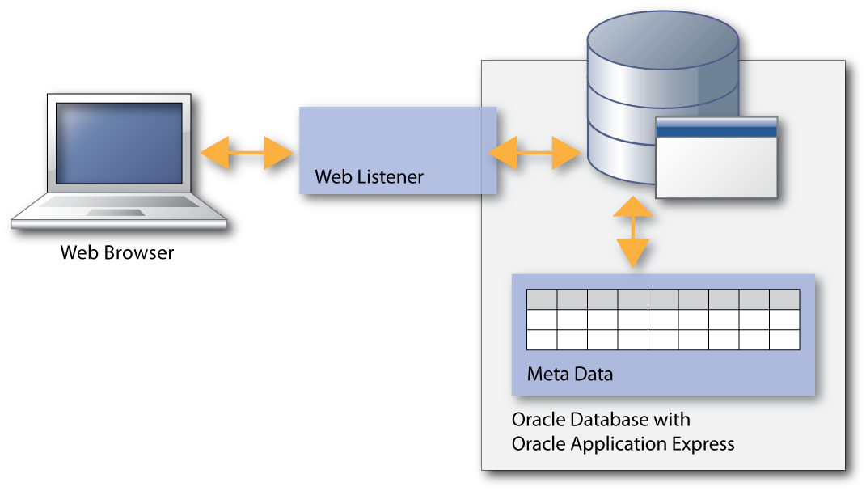
Oracle Application Express (Oracle APEX) Architectural Overview
Simple N-Tier Architecture
Pages dynamically rendered using database Metadata
No code generation or file based compilation
Runs Everywhere Oracle Database Runs
Notes:
8
Discussion Points:
Oracle Application Express Listener Release 1.1 is now available. For those of you unfamiliar with this product, Oracle APEX Listener is a J2EE based alternative for Oracle HTTP Server (OHS) and mod_plsql. The J2EE implementation offers increased functionality including a web based configuration, enhanced security, and file caching. The APEX Listener also provides flexibility by supporting deployments using Oracle Web Logic Server (WLS), Oracle Glassfish Server and OC4J.
The Oracle Application Express architecture requires some form of Web server to proxy requests between a Web browser and the Oracle Application Express engine. The APEX Listener was created to satisfy that need but its use goes beyond that of Application Express configurations. The use of the Oracle APEX listener simplifies the deployment process because there is no Oracle home required as connectivity is provided using an embedded JDBC driver.
Why use the APEX Listener
Allows easy integration with Java-based middleware
Can be used for Application Express or any Oracle web-toolkit application
Ease of configuration
Lightweight
When combined with Glassfish, just unzip and you are good to go

Slide 9
Architectural Overview – APEX.oracle.com
Home to asktom.oracle.com (aliased)
HP DL380
8 CPUs (3.00 GHz)
32 GB RAM
Running Oracle Database Enterprise Edition 11.2.0.2
Oracle Linux 5 64-bit
Notes:
9

Slide 10
Architectural Overview – APEX.oracle.com
In the last week
Total Page Events: 12,182,723
Workspaces Approved: 577
Workspaces Purged: 292
Distinct Users: 8,762
Total Number of Workspaces: 11,806
Total Number of Applications: 43,133
Notes:
10

Slide 11
Architectural Overview – APEX.oracle.com
apex.oracle.com runs:
Oracle Learning Library (about 2M page views)
SQL Developer Check For Updates (about 1.1M page views)
ProMED Mail (about 750K page views)
AskTom (about 674K page views)
APEX Application Builder (about 400K page views)
Notes:
11

Slide 12

APEX 4.1
Automated and Improved Error Handling
Release 4.1 includes improved error handling and user-defined exception processing. You can now easily capture error messages generated by the Oracle database and replace the message text with user friendly text. For example, instead of an error message such as "ORA-00001 unique constraint (EMP_UK) violated" the developer can define a message such as "Employee Name must be unique".

Slide 13
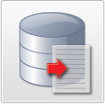
APEX 4.1
Use of ROWID
Application Express now supports the use of ROWID for updates, inserts and deletes as an alternative to specifying primary keys. Previously you could only specific two primary key columns. Therefore, if your table had more than two key columns then you could not use the default DML processes and had to manually write your own processes. Use of ROWID is now the default method for any new DML processes generated.

Slide 14

APEX 4.1
Data Upload
Developers can now easily add the capability for end-users to load spreadsheet data into existing tables within an application. The developer can utilize a wizard to create a collection of pages that allow the end user to upload a file or cut and paste data into a table. Additionally the developer can define lookup columns and data transformations. End users are then led through a runtime wizard which allows them to load the data, map the columns, see whether the data will be inserted or updated, and review the results.

Slide 15

APEX 4.1
Calendar
The calendar wizards have been enhanced to include the ability to create an Edit page as part of creating the calendar. Further calendars can now include drag and drop functionality which allows the end user to change the date and or time of a record by simply dragging it on the calendar itself.

Slide 16

APEX 4.1
Websheets
Building on their initial introduction in Release 4.0, the look and feel of Websheets in Release 4.1 has been substantially improved and the controls redesigned to make it more intuitive for users. There are also new page section types, and enhanced data grid integration.

Slide 17

APEX 4.1
Tabular Forms
Tabular Forms now support all validation types. Depending on the validation type you can use bind variable syntax, substitution syntax, or just specify the tabular form column name. These enhancements allow developers to declaratively define complex validations instead of having to perform extensive manual PL/SQL coding.

Slide 18

APEX 4.1
Plug-Ins
Plug-ins enable developers to enhance the existing built-in functionality by writing PL/SQL components for various components. This release expands the plug-in functionality and introduces the ability to create plug-ins for authentication and authorization schemes.

Slide 19

APEX 4.1
Dynamic Actions
Dynamic Actions allow developers to declaratively define client-side functionality, without needing to master JavaScript and AJAX. With this release, a number of enhancements were added including the ability to define dynamic actions for buttons and also use dynamic actions to set multiple item values.

Slide 20

APEX 4.1
Accessibility
Release 4.1 includes dramatic improvement in the HTML generated by the Application Express engine, together with accessibility improvements in existing themes and HTML templates.

Slide 21
Relevant Sessions
26520 - Oracle Application Express Birds of a Feather (BOF) Session {Monday, 06:30 PM, Marriott Marquis - Salon 9}
15749 - Oracle Application Express Release 4.1 New Features {Monday, 12:30 PM, Marriott Marquis - Golden Gate B}
29600/29623 - A la Carte Oracle Application Express HOL {Tuesday, 03:30 PM, Marriott Marquis - Salon 10/11}
All new 4.1 labs {Thursday, 10:30 AM, Marriott Marquis - Salon 10/11}

Slide 22
SQL Developer

Slide 23
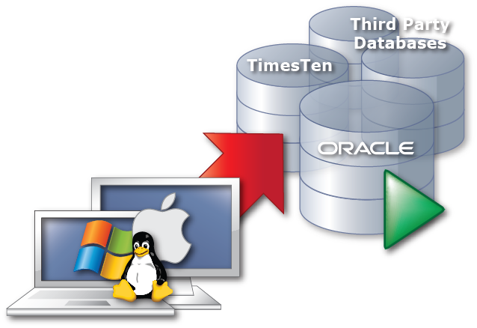
Technology
Technology and Architecture
Portable over many platforms
Java based
Database support
Oracle 9i, 10g, and Oracle 11g
Any JDBC accessible databases
Microsoft SQL Server
DB2
…..
Platform support
Windows
Linux
Mac OSX

Slide 24
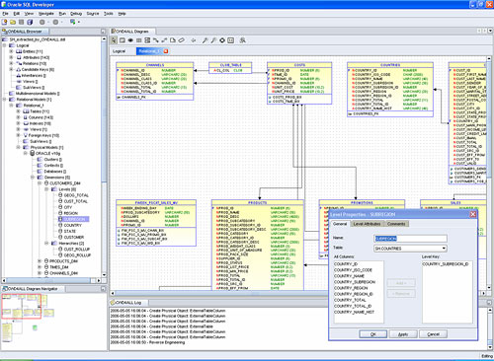

Data Modeling

Slide 25

Data Mining
Oracle Data Miner
Oracle Data Mining, an Option to the Oracle Database EE
Free download from the Oracle Technology Network with SQL Developer 3.0
Oracle Data Miner help users mine their data and define, save and share advanced analytical methodologies
Visualize data, perform data transformations for data mining
Build, evaluate and apply classification, clustering, anomaly detection, text mining, market basket, etc. predictive models
Developers can use the SQL and Java APIs to build applications to automate knowledge discovery

Slide 26
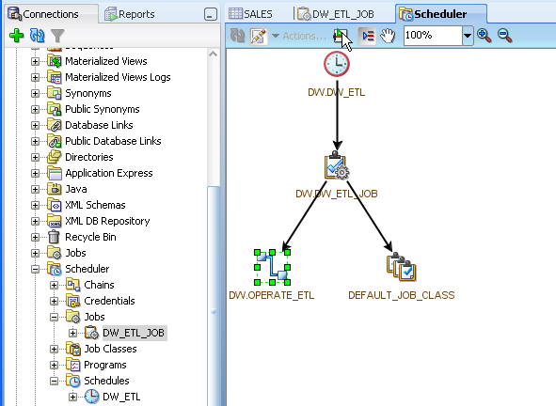
DBMS Scheduler

Slide 27
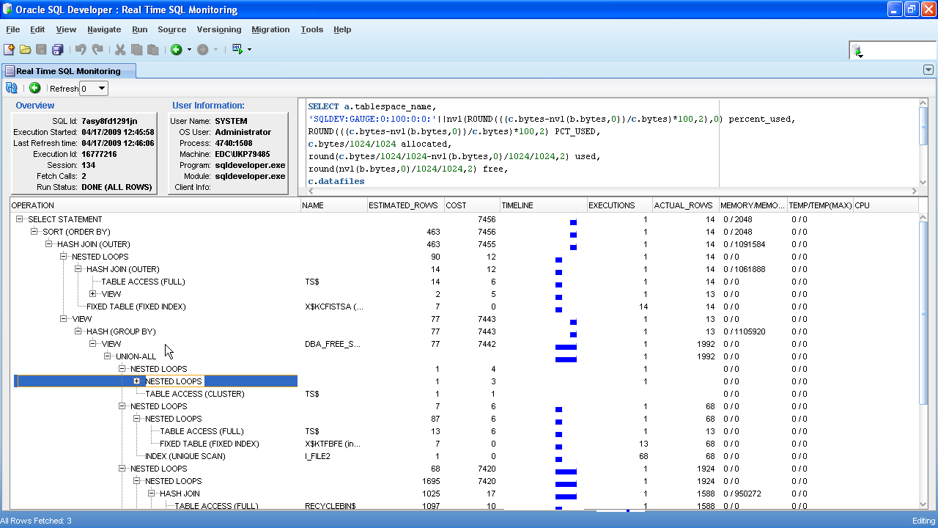
Monitor SQL – Realtime SQL Monitoring

Slide 28
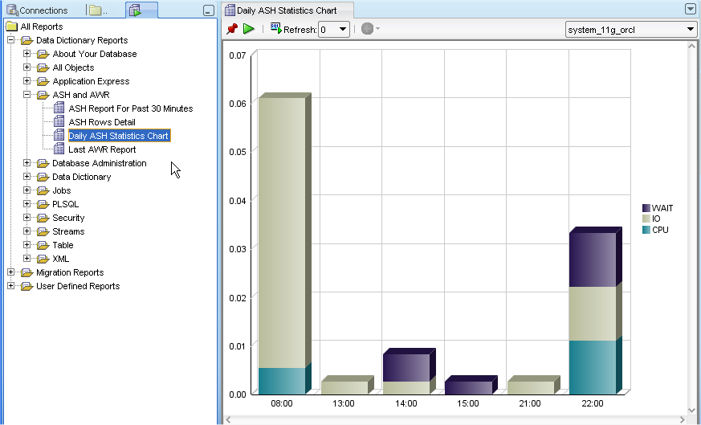
Support for Tuning - AWR & ASH Reports

Slide 29
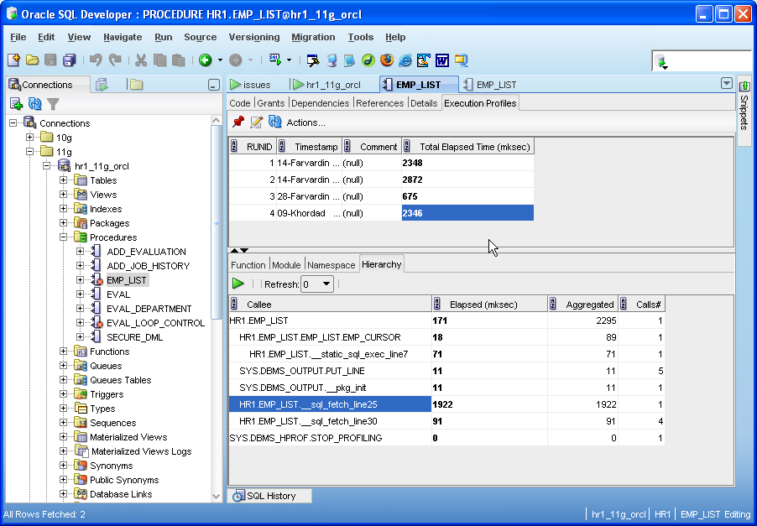
Support for Tuning - Hierarchical Profiler

Slide 30
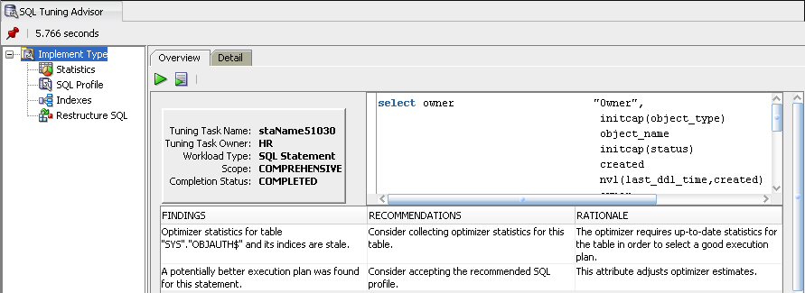
SQL Tuning Advisor

Slide 31
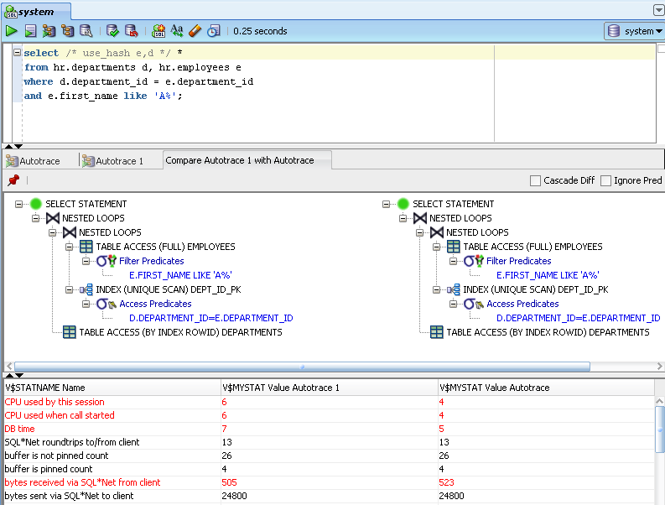
Support for Tuning – ‘Autotrace’ auto-compare

Slide 32
ODP.Net

Slide 33
.NET Components for Oracle Database
Free
Stay in Visual Studio for project lifecycle
Supports Visual Studio 2003 - 2010
Complete access to .NET functionality
Supports .NET Framework 1.0 and higher
Supports 32-bit, x64, and 64-bit Itanium platforms
ASP.NET services and controls via ASP.NET providers
Easy to use and intuitive
Native access to Oracle Database
Utilize advanced Oracle Database features
E.g. RAC, performance, security, data types, XML, etc.
Notes:
33

Slide 34
Oracle Technology Network – .NET Developer Center
http://otn.oracle.com/dotnet
Free downloads
Visual Studio tools, ODP.NET, ASP.NET providers, and more
Oracle .NET education
Whitepapers, sample code, demo videos, discussion forums, step by step tutorials, news
ODAC 11.2.0.2.1 – Current Production release
Notes:
34

Slide 35
ODP.Net
TimesTen In-Memory Database Support
Oracle Data Provider for .NET enables fast data access for any .NET application, such as C# .NET, Visual Basic .NET, and ASP.NET, to TimesTen In-memory databases. ODP.NET support for TimesTen includes the classes, enumerations, interfaces, delegates and structures of the Oracle.DataAccess.Client and Oracle.DataAccess.Types namespaces. ODP.NET supports TimesTen Release 11.2.1.6.1 or later on Microsoft Windows 32-bit and 64-bit platforms. TimesTen can be used with .NET Framework 2.0, 3.0, 3.5, and 4 with Microsoft Visual Studio 2005 or later.

Slide 36
ODP.NET
64-bit ODP.NET XCopy for Windows x64
Now available for Windows x64 systems, ODP.NET XCopy provides system administrators with a smaller client install size than the standard ODP.NET client, and is easier to configure. ODP.NET XCopy simplifies embedding ODP.NET in customized deployment packages.

Slide 37
APEX 4.1
Support for Microsoft .NET Framework 4 and Visual Studio 2010
ODP.NET for .NET Framework 4 supports .NET Framework 4 and the .NET Framework 4 Client Profile. Oracle Developer Tools for Visual Studio supports MS Visual Studio 2010.

Slide 38
ODP.net Sessions of Note…
Entity Framework, LINQ, and WCF Data Services for Oracle Database
Tuesday, 03:30 PM, Marriott Marquis - Salon 8
Introducing the New Thin Oracle Data Provider For .NET
Wednesday, 05:00 PM, Marriott Marquis - Salon 8

Slide 39
Networking

Slide 40
Networking
Net Services - Session Data Unit (SDU)
Controls the size of Net Services packets
Default value = 8k in 11.2 (was 2k in prior releases)
Max is 64K in 11.2 (was 32k)
Very useful for LOB, XML and bulk data movement
Can be set in sqlnet.ora, tnsnames.ora or in URL in connect string e.g., url="jdbc:oracle:thin:@DECSRIPTION=...(SDU=16584) ...)

Slide 41
Networking
Enable SDP over Infiniband
Sockets Direct Protocol, for clustering
Protocol in connect string

Slide 42
Java/PHP/others

Slide 43
Oracle Drivers
Most Oracle drivers support Edition Based Redefinition
JDBC
OCI
OCCI
PHP-OCI8
ODP.Net,

Slide 44
Oracle Drivers
Most Oracle drivers support for LOB Prefetching
Parse
Get LOB locator
Get first chunk of data
One round trip…

Slide 45
Java
UCP - Web-session affinity to a RAC instance
For applications with repeated operations on same client records (online shopping, online banking, self-service HR, etc)

Slide 46
Java
UCP - Transaction affinity to a RAC instance
Automatically localize a global transaction to a single instance

Slide 47
Java
Java in the database
Transparent JIT compilation
JMX to allow monitoring of Java VM using standard JMX-enabled tools (Jconsole for example)

Slide 48
Scalability
Database Resident Connection Pooling
C
C++
PHP
Python
Perl
Client-side Result cache

Slide 49

client
1
3
ds
2
2
Dedicated Server
Slow connection
Has process creation
Short code path however
SGA
Notes:
Spawn DS
Do work in database
Get response
Process stays there until you logoff – it is yours. If you have 1,000 connections, you have 1,000 processes

Slide 50
client
s001
1
7
3
s002
4
2
Request queue
d001
5
4
Response queue
s003
6
Shared Server
Fast connection
No process creation
Long code path however
…
SGA
s00n
Notes:
Get connected to dispatcher
Request queued in sga (could be PARSE, could be FETCH, could be close, could be run this stored procedure, etc)
Request dequeued from sga by SOME shared server
Shared server processes
Puts response back into a queue in sga – SS is now free for anyone else
Dispatcher pulls response and sends to client
To do it all over again – steps 3, 4, 5 are repeated with perhaps some other shared server

Slide 51
client
1
3
ds
2
2
ds
DRCP
Fast connection
No process creation
Short code path
.
.
SGA
ds
Notes:
Establish connection by getting hooked up to an idle dedicated server
DS does work and
Sends response
When you log off – DS goes back into the pool, is not destroyed.
Performance of DS while connected
Performance of SS while connecting
LIMITED CLIENT set – php and the like – java connection pool option coming.

Slide 52
client
ds
ds
DRCP
Fast connection
No process creation
Short code path
.
.
SGA
ds

Slide 53
Database

Slide 54
Gathering Statistics Incremental Statistics
One of the biggest problems with large tables is keeping the schema statistics up to date and accurate
This is particularly challenging in a Data Warehouse where tables continue to grow and so the statistics gathering time and resources grow proportionately
To address this problem, 11g introduced the concept of incremental statistics for partitioned objects
This means that statistics are gathered for recently modified partitions

Slide 55
Gathering Statistics The Concept of Synopses
It is not possible to simply add partition statistics together to create an up to date set of global statistics
This is because the Number of Distinct Values (NDV) for a partition may include values common to multiple partitions.
To resolve this problem, compressed representations of the distinct values of each column are created in a structure in the SYSAUX tablespace known as a synopsis

Slide 56
Gathering Statistics Synopsis Example
Object | Column Values | NDV
Partition #1 | 1,1,3,4,5 | 4
Partition #2 | 1,2,3,4,5 | 5
NDV by addition | WRONG | 9
NDV by Synopsis | CORRECT | 5

Slide 57
EXECUTE and PREPROCESSOR (10.2.0.5)
ops$tkyte%ORA11GR2> CREATE TABLE EMP_ET
2 (
3 "EMPNO" NUMBER(4),
4 "ENAME" VARCHAR2(10),
5 "JOB" VARCHAR2(9),
6 "MGR" NUMBER(4),
7 "HIREDATE" DATE,
8 "SAL" NUMBER(7,2),
9 "COMM" NUMBER(7,2),
10 "DEPTNO" NUMBER(2)
11 )
12 ORGANIZATION external
13 ( TYPE oracle_loader
14 DEFAULT DIRECTORY load_dir
15 ACCESS PARAMETERS
16 ( RECORDS DELIMITED BY NEWLINE
17 preprocessor exec_dir:'run_gunzip.sh'
18 FIELDS TERMINATED BY "|" LDRTRIM
19 )
20 location ( 'emp.dat.gz')
21 )
22 /
Table created.
Notes:
57

Slide 58
EXECUTE and PREPROCESSOR (10.2.0.5)
ops$tkyte%ORA11GR2> !file emp.dat.gz
emp.dat.gz: gzip compressed data, was "emp.dat", from Unix, last modified: Wed Oct 7 12:48:53 2009
ops$tkyte%ORA11GR2> !cat run_gunzip.sh
#!/bin/bash
/usr/bin/gunzip -c $*
ops$tkyte%ORA11GR2> select empno, ename from emp_et where rownum <= 5;
EMPNO ENAME
---------- ----------
7369 SMITH
7499 ALLEN
7521 WARD
7566 JONES
7654 MARTIN
Notes:
58

Slide 59
PL/SQL

Slide 60
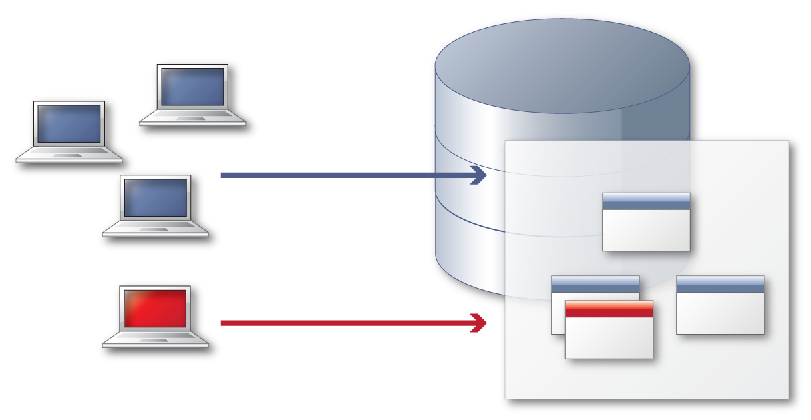
Edition-Based Redefinition Online Application Upgrade
Base Edition
Database objects
New Edition
Allows multiple editions to be available simultaneously
Compilation of editioned objects transparent to application
Views, Synonyms, PL/SQL objects and others can be editioned
Notes:
60
Changes are installed in the privacy of a new edition
Tables contain the application data
Editioning views expose a private projection of the table into each edition
Crossedition triggers propagate changes made in the old edition into the new edition’s columns, or (in hot-rollover) vice-versa
The installation of the upgrade into the production database must not perturb live users of the pre-upgrade application
- Many objects must be changed in concert. The changes must be made in privacy
Data must persist across a patch or upgrade
- Transactions done by the users of the pre-upgrade application must by reflected in the post-upgrade application
For hot rollover, we also need the reverse of this:
- Transactions done by the users of the post-upgrade application must by reflected in the pre-upgrade application
Online application upgrade is a high availability subgoal
Traditionally, HA goals are met by features that the DBA can choose to use at the site of the deployed application
independently of the design of the application
without the knowledge of the developer
The features for online application upgrade are used by developers
when preparing the application for online upgrade
When implementing an upgrade script
DBAs, of course, will need to understand the features

Slide 61
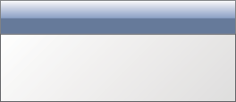


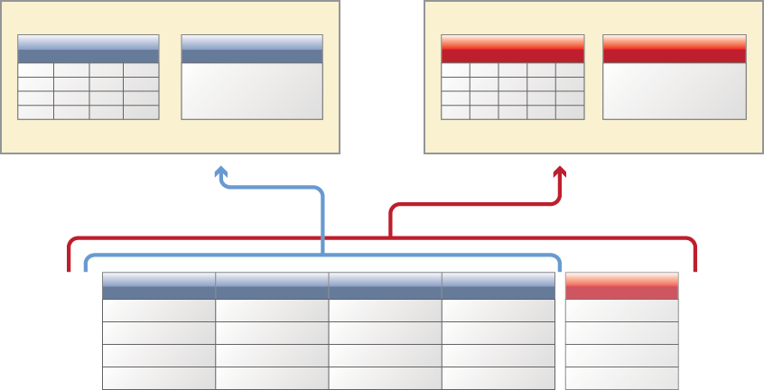

Edition-Based Redefinition Online Application Upgrade
2
Application v1
Application v2
4
View
Procedure
View
Procedure
1
3
Base Edition
New Edition
1
Compile objects in new edition without affecting online users
Test/Deploy new application version in new edition
Current users are not effected, they reference ‘old’ edition
Phase in new application version over time
2
3
4
Notes:
61
Here is how it works
Set edition using “alter session set edition”
Cross edition triggers can be used to maintain data between editions

Slide 62
Q&A

Slide 63



